Slide 1
Sensor Web in EEA
Core Interest and Central Problems in the Sensor Web
Peter Kjeld
SWE workshop at JRC / 28-29 January 2010

Slide 2
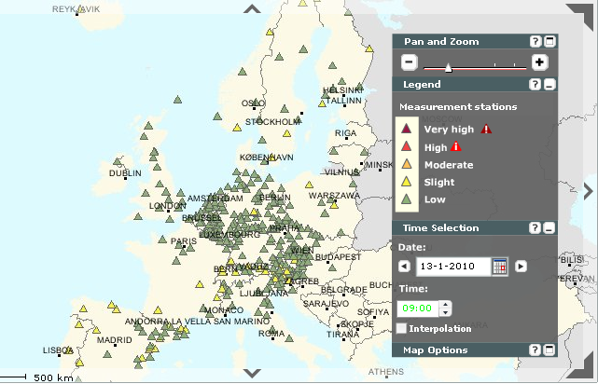
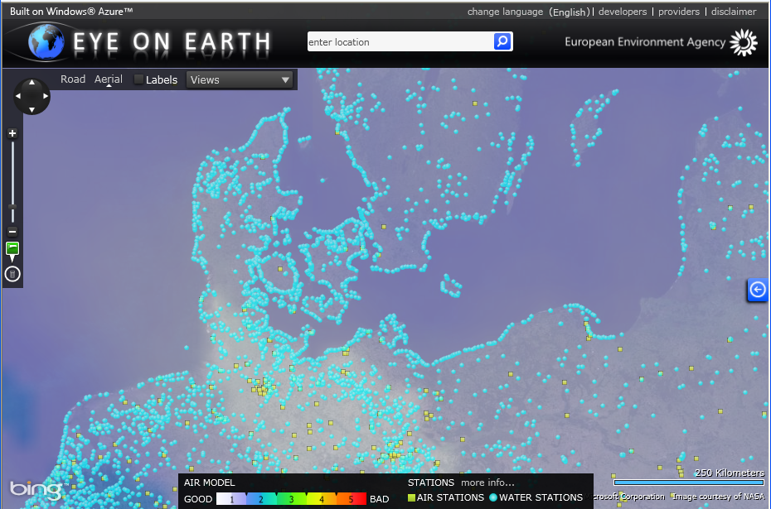
Our current situation
Production environment
Airquality data (hourly)
Bathingwater data (bi-monthly in season)
Properitary dataformats (xml, csv)
OzoneWeb in production (2006)
EyeOnEarth.eu (2009)
System build upon MS Biztalk server and application database
Provides airquality data for various research projects

Slide 3

What future will bring
Growing demand for near real time data
Coordination of GMES in-situ
Serve timely environmental data
Provide better interface for data users
Data on different aggregation level - Cascading data

Slide 4
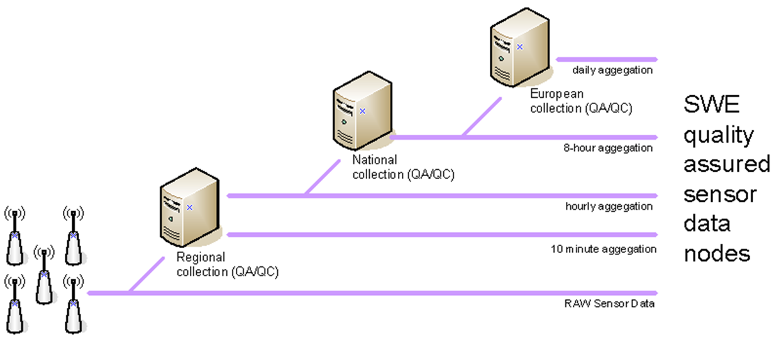
Cascading data

Slide 5
Where SWE don’t help us
  Our lack of mandate
    Convicing member states to SWE is our only tool
  Legal issues
    Publish rights
    Responsibility of correctness of data
    Restrictive access
    However, SWE can on long term make negosiations easier

Slide 6
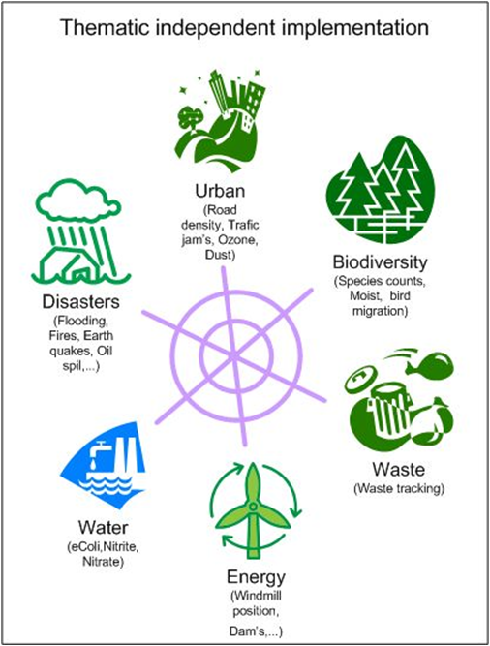
Why we believe in SWE
Matured for production
One open standard
Data re-use
More timely data – faster
Higher efficiency
Thematical independent
High level of interoperability
Standardised access point
Improved expert access
Less ressources to maintain multiple flows

Slide 7
EEA 2010 Objectives
Implement SWE as part of EEA’s NRT platform
  Access to NRT airquality data (SOS - SANY)
  Setup alerting services
  Document lessons learned

Slide 8
Can’t get there alone...
JRC to continue SWE research and initiatives
FP7 projects to prove SWE within MS
...

